Slide 1
Extraction, transformation, loading (ETL) process
Example of ETL to convert medical data to a common data model
Krista Miller 3/7/2022

Slide 2
Purpose
MIMIC is a de-identified healthcare dataset comprised of patients who received critical care in the Beth Deaconess Medical Center between 2001-2012.
Observational Medical Outcomes Partnership (OMOP) is a common data model to standardize observational medical data.
The goal of this project is to show an example of the steps required in the ETL process for standardizing healthcare data.
Specifically, this presentation will show the 7 steps needed to convert MIMIC data into the OMOP CONDITION_OCCURENCE table.

Slide 3
Step 1: Understand source/target data models
CONDITION_OCCURRENCE is the TARGET OMOP table:
Target: CONDITION_OCCURRENCE OMOP CDM V5.3.0
Fields: | Datatype: | Description:
person_id | FLOAT (int 64) | Foreign key identifier to the person who is experiencing the condition. The demographic details of that person are stored in the PERSON table.
visit_occurrence_id | FLOAT (int 64) | Foreign key to the visit in the VISIT table during which the Condition was determined (diagnosed)
condition_source_value | STRING (varchar 50) | Source code for the condition as it appears in the source data. This code is mapped to a standard condition concept in the Standardized Vocabularies. *This is the RAW data from the Source table*

Slide 4
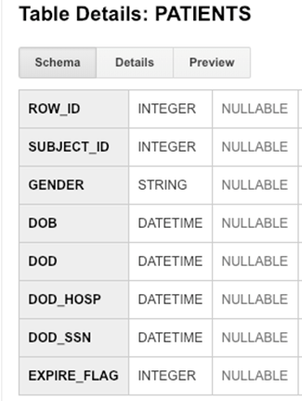
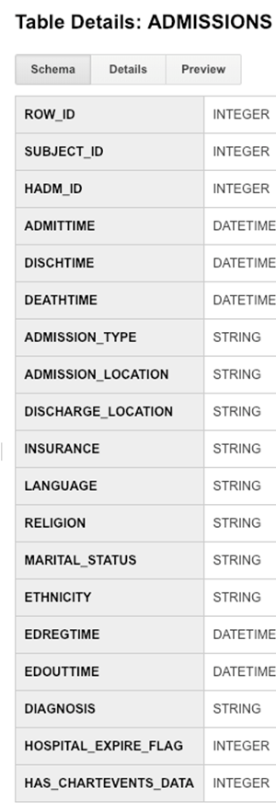
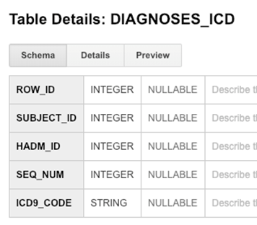
Step 1: Understand source/target data models
The following MIMIC tables contain data for the 3 target table fields. Note the 3 target table fields are available in the DIAGNOSES_ICD table. SUBJECT_ID field originates from PATIENTS table and HADM_ID originates from ADMISSIONS table

Slide 5
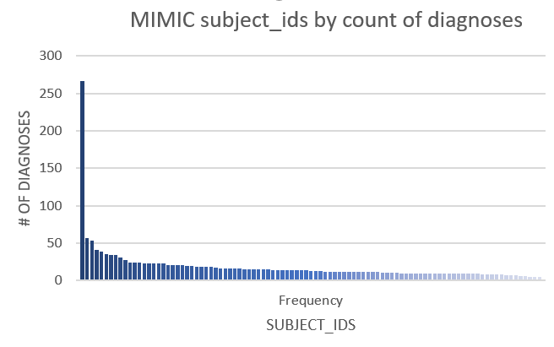
Step 2: Profile source table or tables
White Rabbit tool helps profile source tables:
MIMIC DIAGNOSES_ICD table:
The distribution of diagnoses count for subject_ids in the MIMIC DIAGNOSES_ICD table shows one patient (SUBJECT_ID 41976) who has 266 diagnoses, followed by a sharp drop in the next highest count (57) and a long tail of diagnoses per unique subject_id in the dataset.

Slide 6
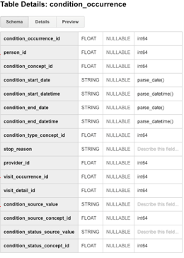
Step 3: Create ETL mappings
- SUBJECT_ID is a unique numerical patient identifier that corresponds with the unique OMOP person_id
-HADM_ID is a unique numerical hospital admission identifier that corresponds with OMOP visit_occurrence_id
-ICD9_CODE is a unique string value that is used as a disease classifier. It corresponds to OMOP condition_source_value field. A source_value field in OMOP will hold the raw value (prior to transformation) of what is stored in the SOURCE table
MIMIC DIAGNOSES_ICD
ROW_ID
SUBJECT_ID
HADM_ID
SEQ_NUM
ICD9_CODE

Slide 7
Step 4 and 5: Write and execute transformation code
-- This code transforms the data from MIMIC tables into three OMOP
-- CONDITION_OCCURRENCE fields (person_id, visit_occurrence_id,
-- condition_source_value).
--Adding OMOP person_id:
WITH diag1 AS (SELECT DISTINCT md.subject_id AS person_id
FROM mimic3_demo.DIAGNOSES_ICD md),
--Adding OMOP visit_occurrence_id:
diag2 AS (SELECT DISTINCT d1.person_id,
md.hadm_id AS visit_occurrence_id
FROM diag1 d1 join mimic3_demo.DIAGNOSES_ICD md ON d1.person_id= md.subject_id),
--Adding OMOP condition_source_value:
diag3 AS (SELECT DISTINCT d2.person_id, d2.visit_occurrence_id,
md.icd9_code AS condition_source_value
FROM diag2 d2 JOIN mimic3_demo.DIAGNOSES_ICD md on d2.person_id= md.subject_id),
--Combining all fields:
condition_occurrence as (SELECT DISTINCT d3.person_id, d3.visit_occurrence_id, d3.condition_source_value
FROM diag3 d3 JOIN mimic3_demo.DIAGNOSES_ICD md ON d3.person_id=md.subject_id)
SELECT * FROM condition_occurrence

Slide 8

Step 6: Perform data quality assessment
--Data quality assessment: find most common ICD9 code from this dataset:
SELECT count(condition_source_value) AS condition_source_value_count, condition_source_value
FROM condition_occurrence
GROUP BY condition_source_value
ORDER BY condition_source_value_count DESC
LIMIT 1
OUTPUT:
I elected to check the value of the most common ICD9 code found in the MIMIC dataset, to validate that it makes sense for a critical care dataset.
ICD9 code 4019 corresponds to “Essential hypertension” as the most common ICD9 code in the dataset, which is expected for this population.

Slide 9
Step 7: Package documentation
The materials in the previous slides constitute a complete ETL package documenting:
-what was done
-decisions/assumptions made
-SQL transformation scripts

